Slide 1
Deployment Objectives
Coverage
Connectivity
Topology

Slide 2
Deployment - Issues
Structured Vs Random Deployment
Over Deployment Vs Incremental Deployment
Network Topology
Homogeneous Vs Heterogeneous Deployment

Slide 3





Ideal Deployment

Slide 4

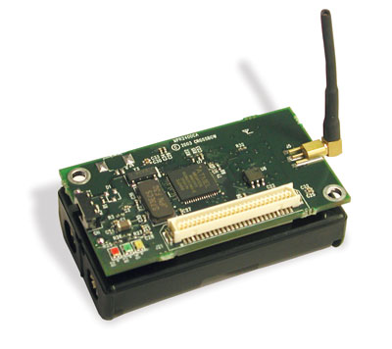
Random Deployment

